Slide 1
Don’t just Code it—Generate it!
Kevin J Mackey

Slide 2
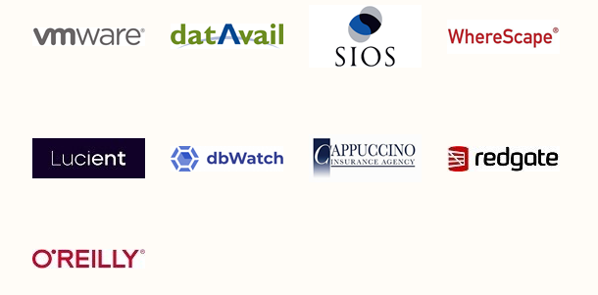
Thank You to our Sponsors!

Slide 3
About
History/Why
Code Generator Anatomy
Final Thoughts
Kevin J Mackey
kevin@mackey.name
http://kjmackey.wordpress.com
@kevinjmackey

Slide 4
About
History/Why
Code Generator Anatomy
Final Thoughts
Kevin J Mackey
kevin@mackey.name
http://kjmackey.wordpress.com
@kevinjmackey

Slide 5
About
History/Why
Code Generator Anatomy
Final Thoughts
Kevin J Mackey
kevin@mackey.name
http://kjmackey.wordpress.com
@kevinjmackey

Slide 6
About
History/Why
Code Generator Anatomy
Final Thoughts
Kevin J Mackey
kevin@mackey.name
http://kjmackey.wordpress.com
@kevinjmackey

Slide 7
About
At this thing a long time. Hate the rain.
Been working with an unhealthy focus on Service Broker for the past few years. Prior to that architect at a failed startup.
If I grow up, I hope to finally make a decent chocolate éclair.
I keep trying things at home.

Slide 8
You know what they say:
Use metadata to make your code do what you want.

Slide 9
I say:
Use metadata to make your code.

Slide 10

I say:
Use metadata to make your code.
Do what you want.

Slide 11
History/Why

Slide 12
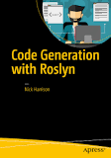
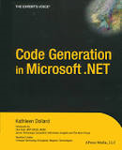

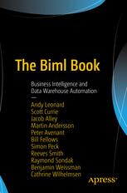
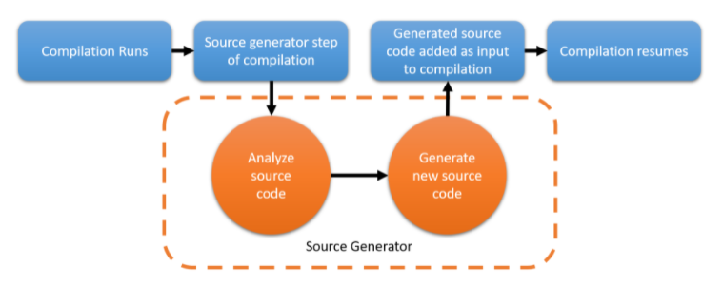
History/Why
Back in the day: COBOL Generator
Up to 2017 (Nick Harrison)
Back in 2004 (Kathleen Dollard)
2017 and beyond: Telosys (Laurent Guerin)
Still in 2017 (Bill Fellows et al.)
2020 C# Code Generators

Slide 13
Says who?
Rocky Lhokta: “You know you need a code generator when your coding process can be described as an algorithm.”
Alan Cameron Wills et al: "To obtain the full benefit of code generation, try to generate program code instead of configuration files."
Remus Rusanu: "...I think you should use some sort of template/code generation when creating SSB activated process…”
Nick Harrison: “...get the best of both worlds by using table-driven business logic to drive the generation of compiled code…”

Slide 14
Why?
We’re already doing it:
“Old code lying around”
Stack Overflow
MSDN Doc Pages

Slide 15
Why?
Sometimes there’s just too much to do
Service Broker messages:
Queues
Services
Routes
Stored Procedures
Angular!

Slide 16
How?
We’re already doing it:
Some of our “Old code”
Global Search & Replace
Fix the results of the above…
Extend samples we found (or Quickstarts)
Code Snippets/Templates

Slide 17
How?
We’re already doing it:
Some of our “Old code”
Global Search & Replace
Fix the results of the above…
Extend samples we found (or Quickstarts)
Code Snippets/Templates
Maybe: write a String.Replace() function that gets rid of some of the drudgery

Slide 18
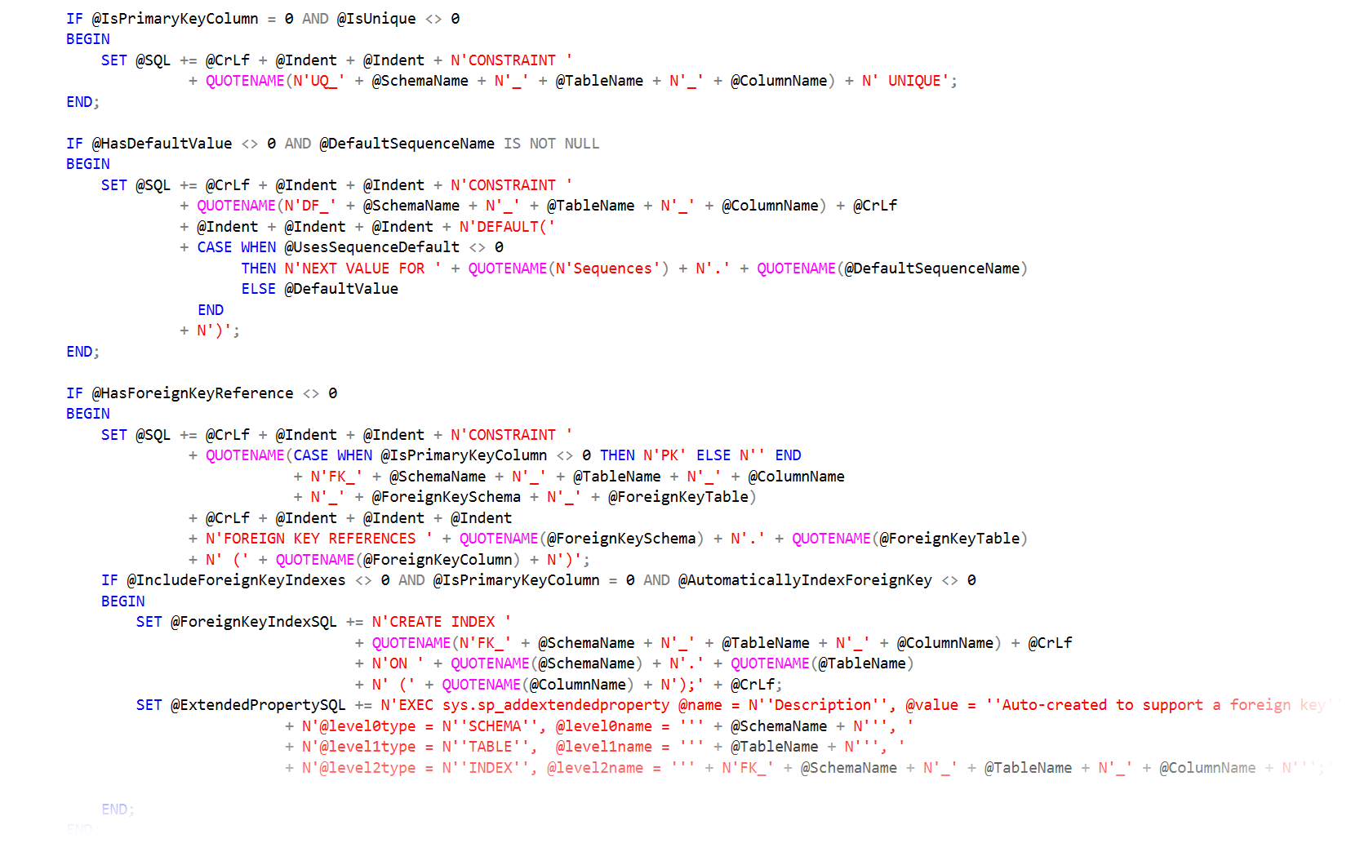
How? Dynamic SQL

Slide 19
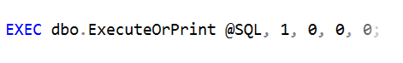
How? Dynamic SQL
then somewhere at the end…

Slide 20
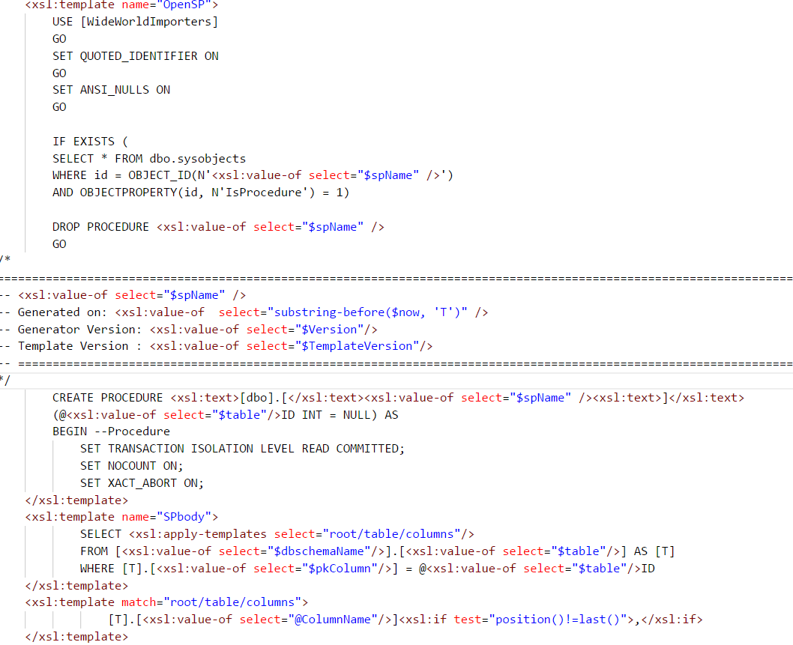
How? Templates

Slide 21
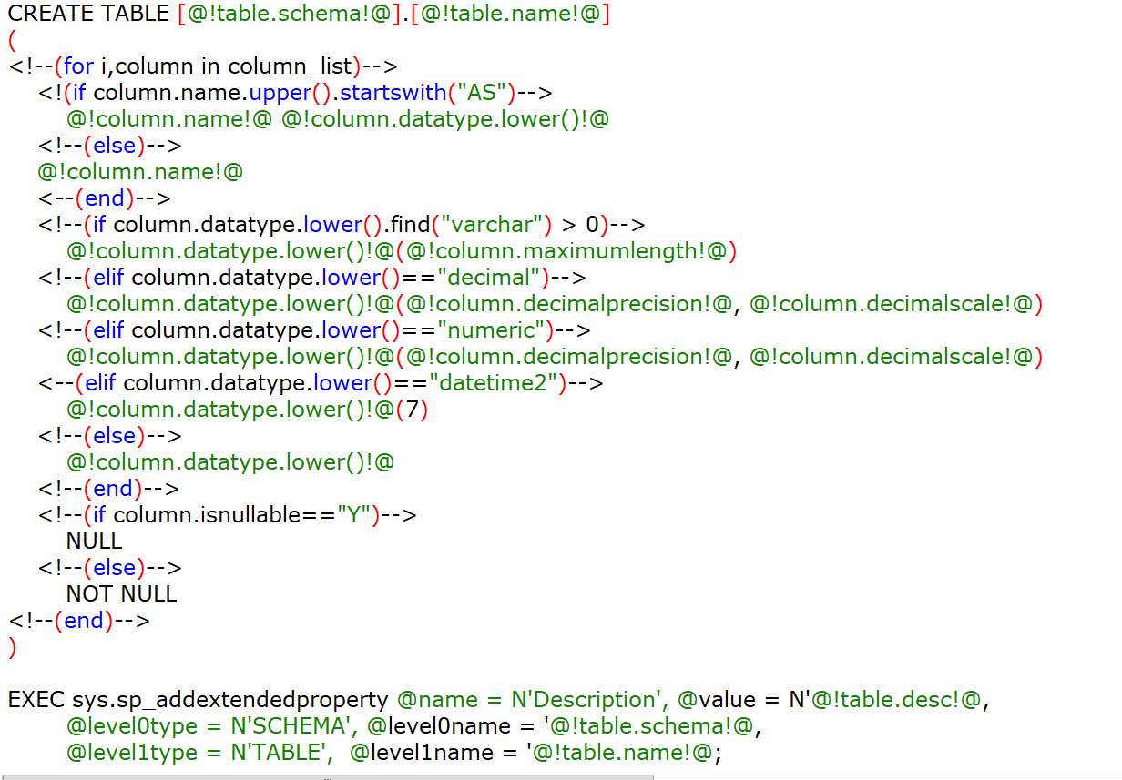
How? Templates

Slide 22
Code Generator Anatomy

Slide 23
Code Generator Anatomy
Metadata
matched with…
Some Template(s)
by a…
A Driver program

Slide 24
Metadata
Three types:
Natural
Hybrid
Custom

Slide 25

Metadata—Natural
INFORMATION_SCHEMA (or sys.objects)
Schema
Tables
Columns

Slide 26
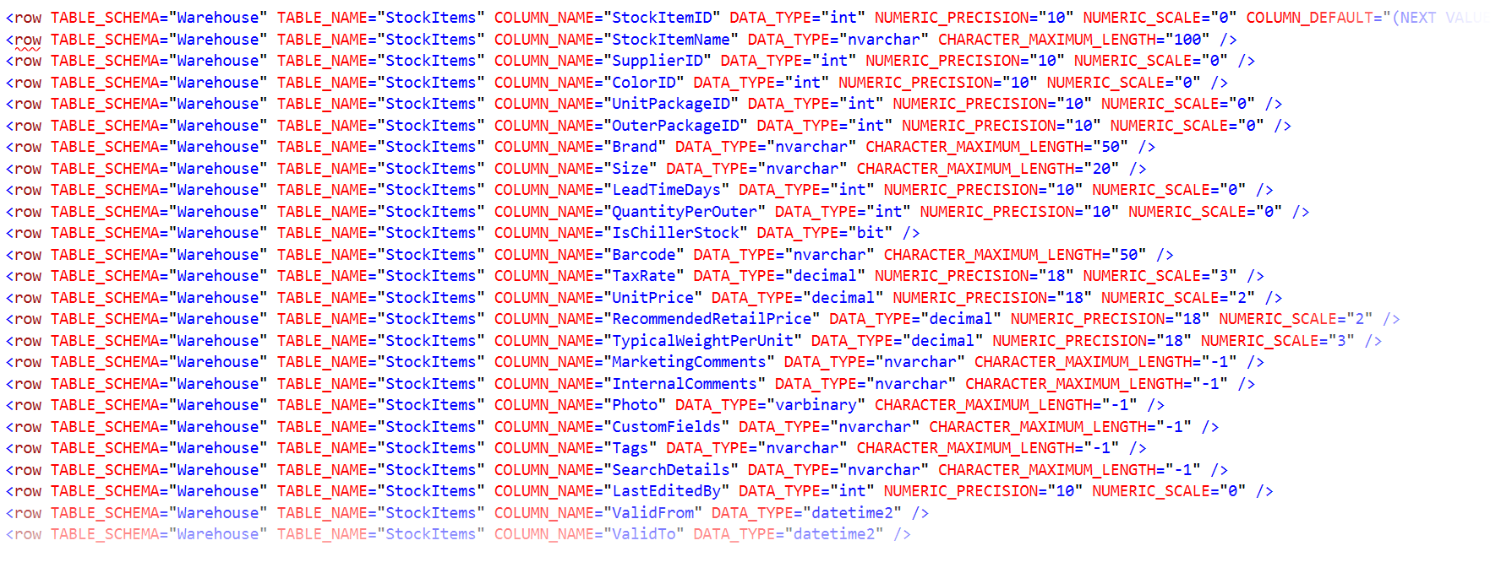
Metadata—Natural

Slide 27
Code Generator Anatomy
Metadata—Natural (in XML)
matched with…
An XSLT Template
by a…
A C# program

Slide 28
Code Generator Anatomy
Metadata—Natural (in XML)
matched with…
An XSLT Template
by a…
A C# program Let’s see…

Slide 29
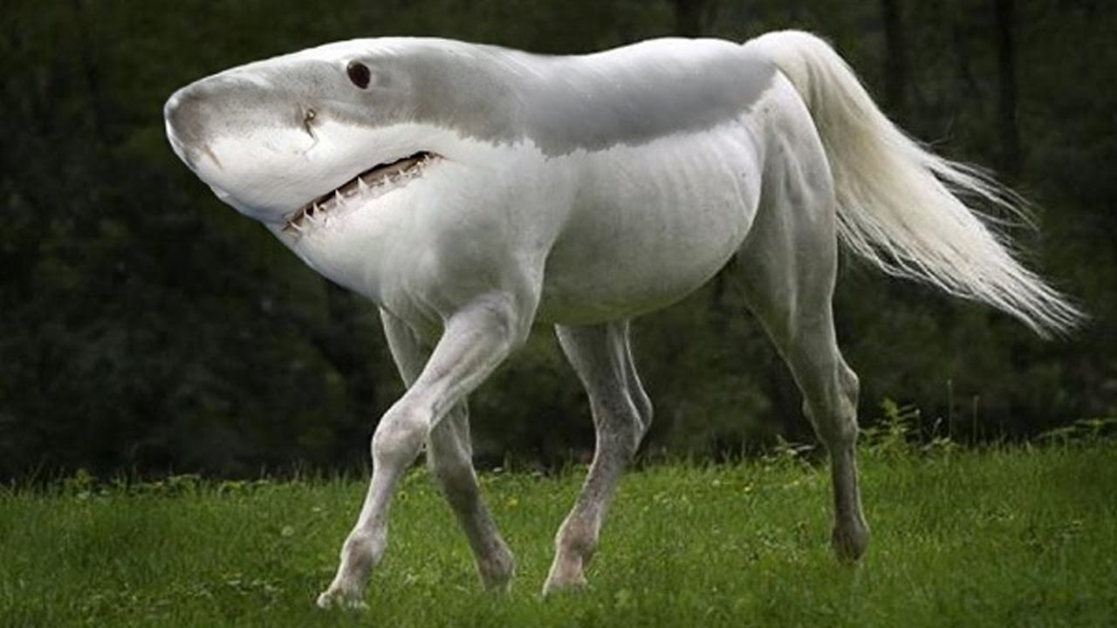
Metadata—Hybrid
INFORMATION_SCHEMA (or sys.objects)
plus…
Parent/Child tables
Entity grouping
Operation ordering
Parallel/Serial

Slide 30
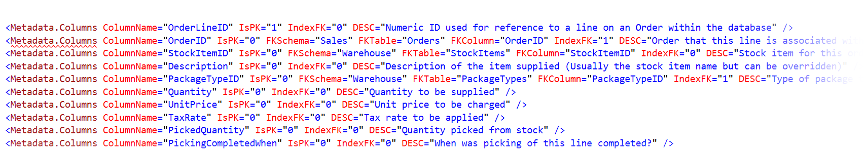
Metadata—Hybrid

Slide 31

Metadata—Custom
Business Rules (anything goes)
Computed Columns
Dimension/Fact tables (and types)
Source/Target Mapping
Metadata Versions

Slide 32
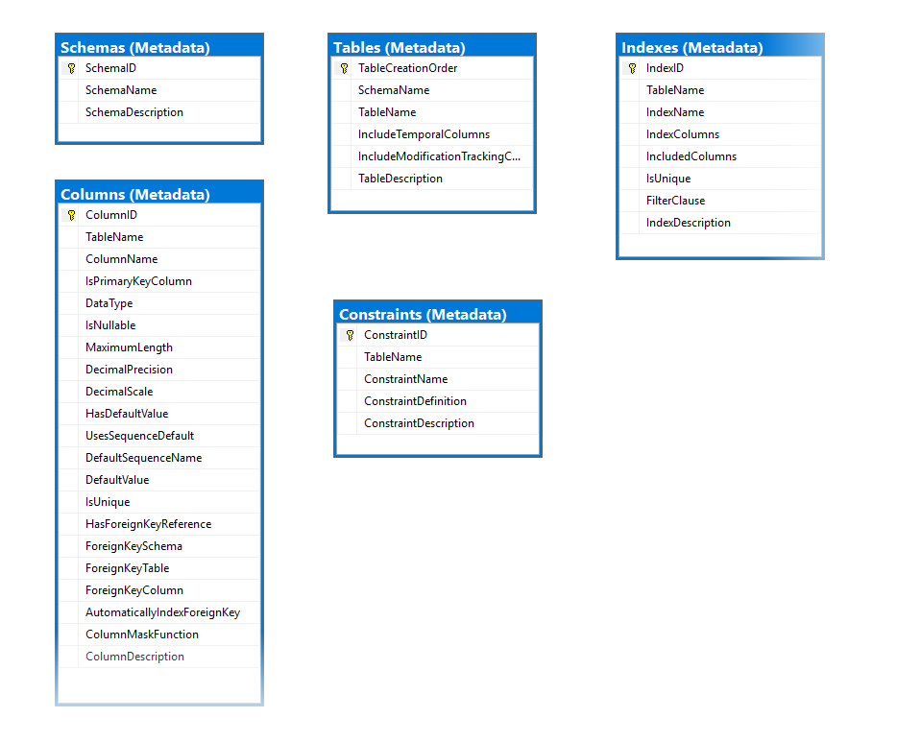
Metadata—Custom

Slide 33
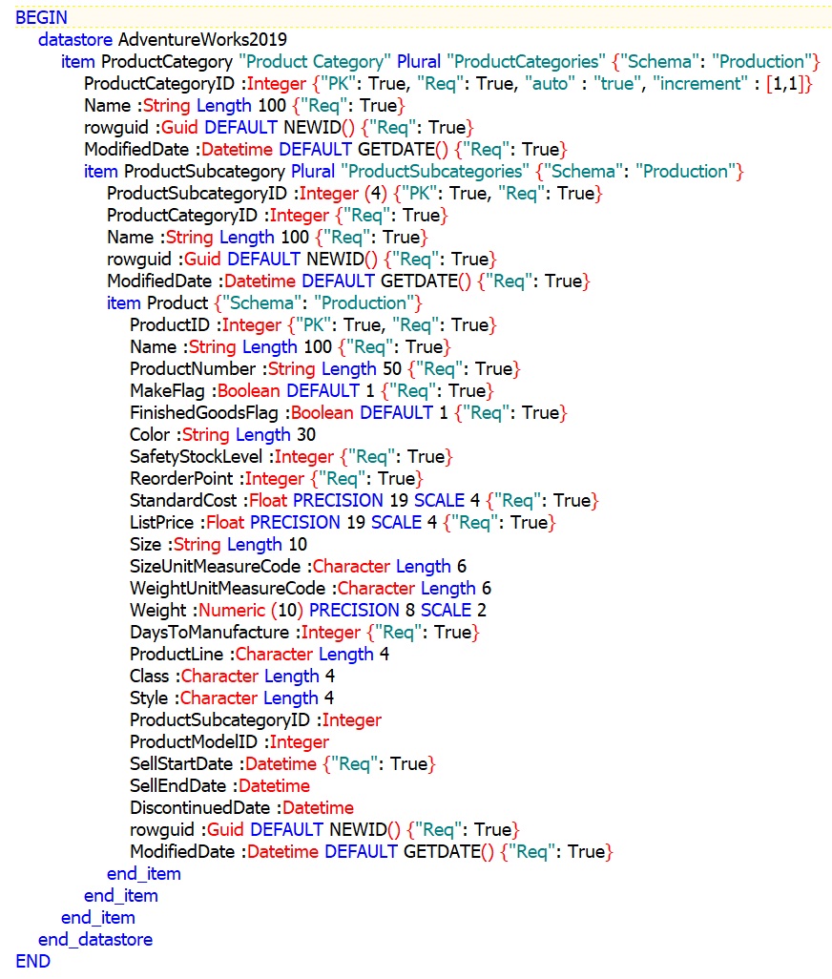
Metadata—Custom

Slide 34
Code Generator Anatomy
Metadata
matched with…
Some Template(s)
by a…
A Driver program

Slide 35
Template(s)
Dealer’s Choice:
XSLT
Text Template Transformation Toolkit (T4)
StringTemplate (Java engine—from the ANTLR guy)
Python libraries
Microsoft’s Roslyn compiler
Telosys (Engine based on Apache Velocity)
BIML

Slide 36
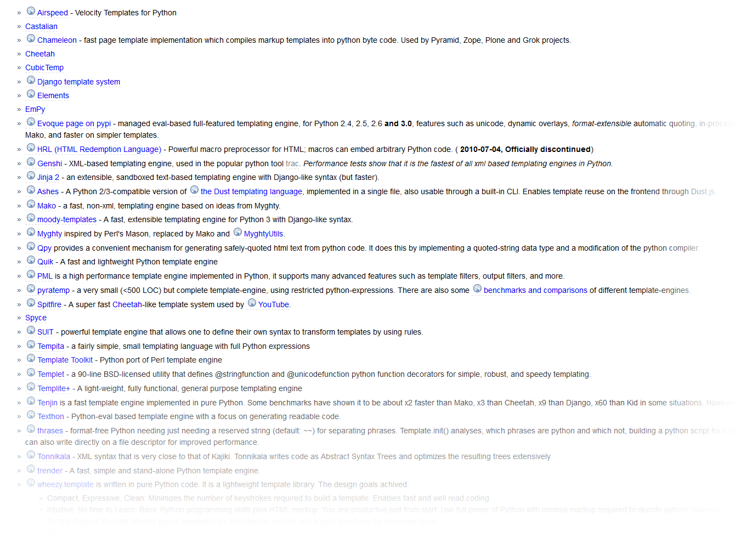
Template(s)—Python

Slide 37
Template(s)
What to look for:
Looping structures
Conditional expressions
Macro capability (code reuse)
Include file capability (code reuse)
Simplicity

Slide 38
Template(s)
Examples of pyratemp templates
CRUD Stored Procedures
XPath Parsing
C# code generation (why not?)

Slide 39
Template(s)
Template approaches
Make decisions in the template—not in the generated code
Don’t use this kind of syntax: Object_Name(@@PROCID) Generate the hardcoded value
Use macros/includes where you can (code reuse)
You know you have your metadata right if you can use it for more than one template

Slide 40
Code Generator Anatomy
Metadata
matched with…
Some Template(s)
by a…
A Driver program

Slide 41
A Driver Program
Anatomy of a driver program:
Command Line parser (what to do?)
Acquire metadata in a form useful to the template(s)
Merge the template(s) and metadata

Slide 42
Code Generator Anatomy
Metadata -»Azure Tables
matched with…
Some Template(s) -»Pyratemp (in Blobs)
by a…
A Driver program -»Azure Functions (and JSON)

Slide 43
A Driver Program
Anatomy of a driver program (using Python)
argparse
pypyodbc
pyratemp

Slide 44
A Driver Program
Anatomy of a driver program (using Python)
argparse
pypyodbc
pyratemp
Let’s take a look

Slide 45
Final Thoughts
Metadata
All you need/As little as you can get away with
You’re not creating a product/writing a book
Templates
Choose what works/Can be maintained
Re-use metadata & drivers for multiple templates
Resources (Slides & Code Samples)
kevinjmackey/SQLSaturdayLA2021 (github.com)

Slide 46
And finally…
???

